Slide 1
AI - Game Changer
Whether you fear it or embrace it, the A.I revolution is coming.
Data is not the new oil - it's the new soil

Slide 2
AI
Our world is constantly changing in many ways. One of the things which is going to huge impact on our future is AI.
It is believed by many people that AI is bringing another industrial revolution.
First industrial revolution expanded our mechanical power. This will expand our cognitive abilities(mental power).

Slide 3
Know it! else?
Artificial Intelligence, deep learning, machine learning - whatever you’re doing if you don’t understand it - learn it. Because otherwise you’re going to be a dinosaur within 3 years.
Whether you fear it or embrace it, the A.I revolution is coming.
Data is the new oil and digital is the new currency
Notes:
Our world is constantly changing in many ways. One of the things which is going to huge impact on our future is AI. It is believed by many people that AI is bringing another industrial revolution. First industrial revolution expanded our mechanical power. This will expand our cognitive abilities(mental power).

Slide 4
AI in day to day life
Google - Helping users find the right thing when they search
Youtube / Netflix Recommendations
Facebook photos detecting faces and persons
Facebook recommends you add the person you had a crush on in college
Amazon’s - customers who bought this also bought this
Talk to an Alexa, Siri, google assistant
Google photos - searching photos
Filter an image in prisma
Portrait mode in nexus
Smart reply in Gmail / Linkedin
Notes:
• Google, trying to answer your query with the best possible results ? This is a ranking problem — helping users find the right thing when they search.• Netflix or Youtube suggesting movies or songs to customers that they might be interested in? This is a recommendation problem — giving users things they may be interested in, without them explicitly searching.• Zillow predicting your house prices? This is a regression problem — predicting a numerical value of a thing.• Gmail marking an email as spam/not spam? This is a classification problem — figuring out what kind of thing something is.• Facebook photos detecting faces? This is a also classification problem.○ Facebook recommends you add the person you had a crush on in college• Amazon’s world famous “customers who bought this also bought this” ? This is clustering in action — Putting similar things together.• Searching old photos in google photos• Filter an image in prisma• Talk to an amazon echo, siri or googleSelect a smart reply in Gmail / Linkedin

Slide 5
Every industry wants intelligence
Machine vision
Natural language processing
Medical field
Radiology
Finance
Marketing and sales
Fraud detection
Agriculture etc,,

Slide 6
Impact of AI
Academic Papers - 9x(After 1996)
Investment in AI - 6x(After 2000)
Active AI startup - 14x(After 2000)
Jobs - 4.5x(After 2000)
Revenue from AI is expected to grow up to 32B by 2025.
87% of current AI adopters said they were using or considering using AI for sales forecasting and for improving e-mail marketing

Slide 7
Acquisition
Google - 3.9 Billion(29 Companies)
Amazon - 871 million
Apple - 786 million
Microsoft - 690 million
Salesforce - 33 million
Salesforce Ventures launches $50M fund to encourage AI development on Salesforce platform
*All amounts are in USD($).

Slide 8
Recommendation engine
Netflix - 75% of the video watched from recommendation engine. According to Netflix executives Carlos A. Gomez-Uribe and Neil Hunt their recommender system saves them about $1 billion
Amazon - Amazon credits it recommendation engine for 35% of their revenue.

Slide 9
AI Types
Narrow AI
General AI

Slide 10
AI History and Introduction

Slide 11
Common Methods and Algorithms
Classic Programming
Rule-based and Expert Systems
Search
Genetic Algorithms
Machine Learning
Deep Learning
Reinforcement Learning

Slide 13
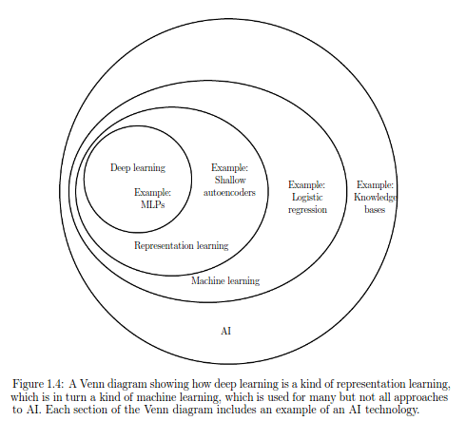
What is AI

Slide 14
What is Machine Learning?
Can we get the computers to learn from its experience ?
Yes
That's what Machine Learning is !!!!
here the experience is nothing but the data
Teaching computers to learn to perform tasks from past experiences
Notes:
AI --> machine learning --> Deep learning (three circles)Traditional programming techniques Understand Problem -> Write rules -> Evaluate program -> Analyse errors -> Again start from beginning if we have errors. ML Techniques Understand problem -> Give training data -> Evaluate using test data -> Check accuracy If accuracy is not satisfying improve accuracy by adding more data(We can automate this) By adding huge amount of data we can detect patterns for complex problem such as speech recogitation

Slide 15
Machine learning
Machine learning learns from examples. Learns from data.
Machine Learning (ML) is a specialized sub-field of Artificial Intelligence (AI) where algorithms can learn and improve themselves by studying high volumes of available data.
Emerging of machine learning is largely because of neural network and increase in amount of data(Thanks to web)
If machine learning is king, data is his queen. If you don't have enough, or rich, training data, no machine learning algorithm is going to work

Slide 16
Why Use ML
Traditional programming techniques
Understand Problem -> Write rules -> Evaluate program -> Analyse errors ->
Again start from beginning if we have errors.
ML Techniques
Understand problem -> Give training data -> Evaluate using test data -> Check accuracy
If accuracy is not satisfying improve accuracy by adding more data(We can automate this)
By adding huge amount of data we can detect patterns for complex problem such as speech recogitation

Slide 17
Rule of thumb : What AI can do ?
AI can't do anything
Anything a typical person can do with less than a second of thinking, we can now or soon automate
Predicting outcome of next in sequence of events
Tasks in which already humans good at : AI do well
Notes:
Rule of thumb for PM's to think for use casesThough its an imperfect rule, it may help in finding usecases. : false positives may occur Eg: person identification, Security person workTime series problems : Zia Anamoly detector, anamoly detection systems, Tasks in which already humans good at : AI do well Eg: Image classification, speech recogonition, /// Predicting sales price prediction is still a difficult tasks

Slide 18
Myth : AI can do anything - deleteeee
ML is not a magic wand for your business until we find out the business impact our feature going to drive
ML is a hammer — but if you don’t have a nail, a hammer is not particularly useful
Machine learning can't clean data
ML is should be treated as co-pilot, not an auto pilot
We have great hammers, bring us some good nails to nail it.
Notes:
ML is not a magic wand for your business. The first challenge in ML is figuring out the business impact the technology aims to drive. ML is a solution — you need to first define the problem: What are the business results you’re hoping to achieve with ML? What benefit can ML provide for your customers? ML is a hammer — but if you don’t have a nail, a hammer is not particularly useful. To stretch the cliché even further, ML is a hugely varied set of hammers, and the kind of nail you have will determine which hammer you’ll pick and how you’ll use it. The precise problem you’re trying to solve will dictate everything — how the result will be used, what your model should predict and how it should be calibrated, what data you collect and process, what algorithms you test and many other questions.At its core, “what problem are we solving?” is a business question, which means defining it is ultimately the responsibility of product managers and business leaders, not data scientists. Data scientists and other stakeholders should absolutely be involved in getting to the definition — just don’t throw the question at them and expect them to come back with answers. If you have data that you don’t know what to do with, conduct customer interviews and ideate with other customer-facing people across the organization. Data scientists can help you explore your data, ideate and iterate, but unless they have a lot of problem space expertise it would be difficult for them to come up with the business case on their own. In order to maximize the value of ML to the business you need an ongoing collaboration between product managers and data scientists, where it is the responsibility of the product managers to ensure that the problems being solved are the most impactful ones for the business.

Slide 19
Types of learning
Supervised learning - THE BOSS
Unsupervised learning
Transfer learning
Reinforcement learning
Regression, classification
Clustering
Association rules
Anamoly detection
Recommendation systems
Time series
NLP
Notes:
Economic values up to down.98% business value is driven by supervised learning (A --> B)Supervised learning Tagged data is needed. Ex: Sentiment analysis Unsupervised learning Tagged data is not needed. Ex: Clustering, recommendation engine Reinforcement learning Ex: Chess boardSupervised - Regression, classificationUnsupervised - clustering,AssociationAnamoly detectionRecommendationtime series

Slide 20
ML Development Life cycle
Define Business objective
Pull and acquire data
Explore and transform data
Prototype and develop model
Model evaluation and validation
if ( Model meets business needs)
Build production systems
Deploy
else
Repeat from step 2
Notes:
Refer the clean loop diagram

Slide 21
Error Metrics and concepts
Under fitting
Over fitting
Accuracy
Precision
Recall
F1 Score
Confusion matrix
etc.,
Notes:
Accuracy Precision Out of all we predict what % is our supposed target Recall Did we catch all our target? F1 Score The harmonic mean of precision and recall

Slide 22
Confusion Matrix
True Positives : The cases in which we predicted YES and the actual output was also YES.
True Negatives : The cases in which we predicted NO and the actual output was NO.
False Positives : The cases in which we predicted YES and the actual output was NO.
False Negatives : The cases in which we predicted NO and the actual output was YES.

Slide 23
Measuring Model
Accuracy
number of correct predictions made by the model over all kinds predictions made.
Precision
Out of all we predict what % is our supposed target
Recall
Did we catch all our target?
F1 Score
The harmonic mean of precision and recall

Slide 24
Metrics Example
Accuracy = 10+70/ 100 = 0.8
Precision = 10/100 = 0.1
Recall = 10/40 = 0.25
F1 = 2((0.1*0.25)/(0.1+0.25)) = 0.14
 | Cancer | Not cancer
Real | 10 | 90
Predicted | 30 | 70

Slide 25
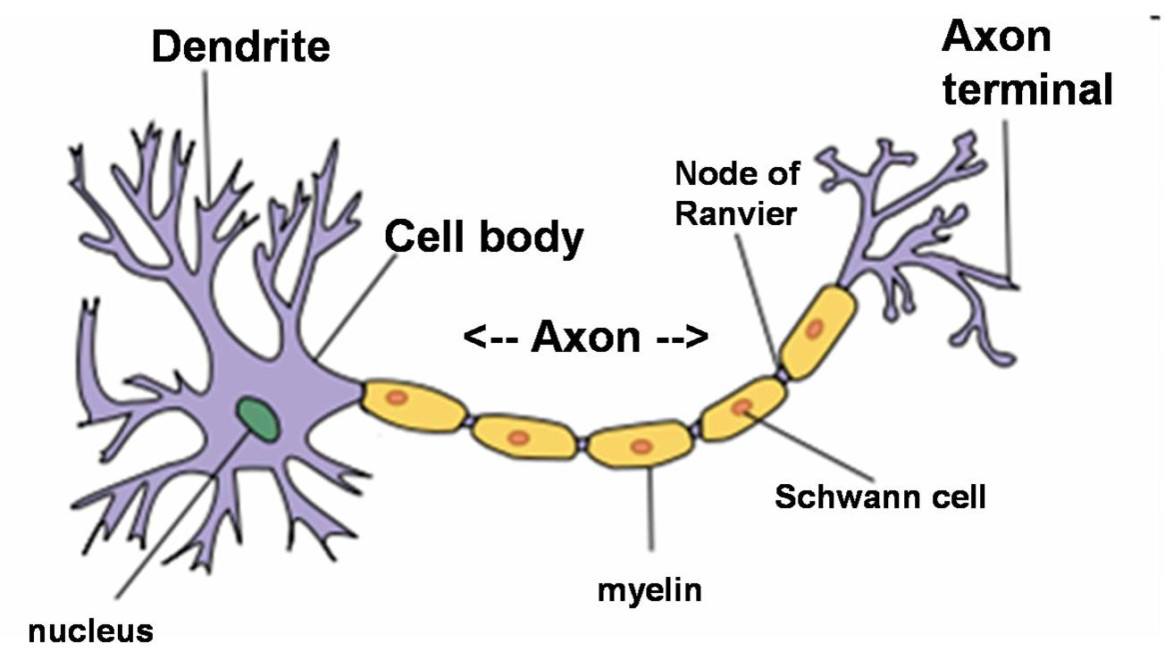
Neural Network
Neural network is one type of machine learning.
Initial model for neural network is developed from Brain neurons.

Slide 26
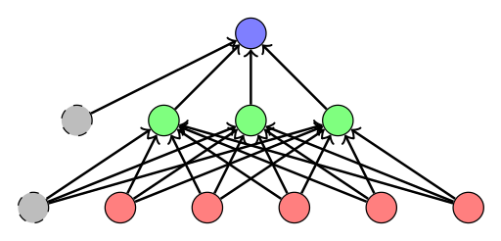
Neural Network

Slide 27
Rise of Deep learning
Computational power let neural network to grow exponentially.
Humans have many billions of adjustable parameters. Even the most complicated ANN only have several million learnable parameters.
Research papers from Google and FB are changing ML field.
Currently most of the paper which said to revolutionize ML field is mostly on Deep learning only.
Most of the data in world generated in last three years!

Slide 28
Keep in mind!
Is the prediction we are going to solve is complex enough to use ML?
Speech recogitation, spam filtering, recommendations
Can we collect new and clean data.
Clean data is better than big data.
data should be clean, free of biases and free of anomalies
The number one rule we follow is: “Your model will only ever be as good as your data.”
Does our data have existing labels.
Does this problem allows some error.
Machine learning or deep learning will have some percentage of error.

Slide 29
No Free Lunch Theorem
There is no universally effective AI method.
Every problem-solving procedure has some computational cost for each task, and none of these procedures is better on average than others.
While this theorem has not yet been proved in the most general case, practice has shown it’s significance.

Slide 30

Some methods may look particularly wonderful, but you still can’t eat them :)

Slide 31
“As soon as it works, no-one calls it AI anymore.”―John McCarthy

